Slide 1
Qualitative Research II: Focus Groups

Slide 2
Focus Group Defined…
A focus group is a group interviewing method used to obtain insights into people’s perceptions, beliefs and language related to a particular issue (in this case, brand awareness, associations, and meanings).

Slide 3
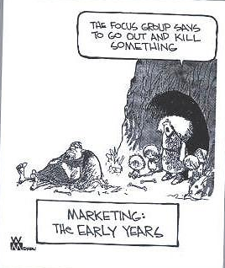
One of the Oldest Forms of Research

Slide 4
Participants
8 to 12 participants (generally) but may be as small as 5 or 6
Participants should be homogeneous in ways that correspond with audience segmentation criteria
Participants should not know each other too well (do not need to be total strangers, however)

Slide 5
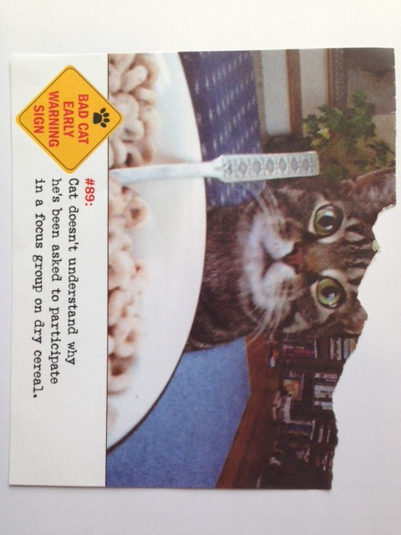
Recruitment
Create a short questionnaire designed to screen potential participants
Recruit at least two more people than necessary (to make up for no-shows)
Participants should not be experts on the topic
Provide incentive to encourage participation

Slide 6
Environment
Neutral and comfortable setting (living room)
Avoid distractions (telephone, people walking through)
Set up to allow eye contact among all participants and moderator
Record sessions (audio and/or video)
One-way mirror (optional)

Slide 7

An Actual Focus Group Facility

Slide 8
Questions
Moderator should follow a “topic guide” – an outline of key topics to be covered to help discussion on track (8 – 12 main questions with several follow-up questions)
Begin with brief introductions
Describe overall objectives of group
Avoid yes/no questions (discussion stoppers)

Slide 9
Questions (2)
Use brief preliminary questionnaire for main topics to be covered (to encourage broad participation)
Flow (funnel) from general issues to more specific/sensitive issues
Key issues should evolve naturally, without moderator having to bring them up

Slide 10
Beginning/Probing Questions
Hypothetical situation: “When are you most likely to eat a candy bar?”
Top of mind associations: “What is the first thing you think of when I say ‘Snickers’?”
Meaning of the obvious: “What does _____ mean to you?”
Chain of questions: “Why is that important to you?”
Sentence completion: “The best thing about (this product) is…”

Slide 11
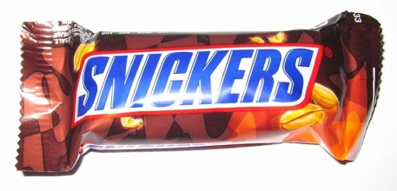
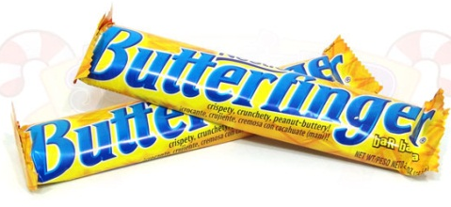
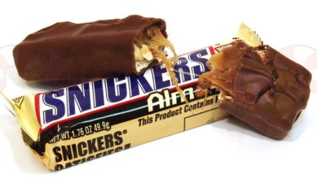
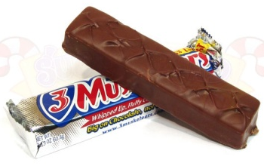
Funneling Questions
When I say candy bar, what first comes to mind?
What is the first brand that comes to mind?
What advertising comes to mind regarding candy bars?
When/where are you likely to purchase a candy bar?

Slide 12
Funneling Questions (2)
When I say chocolate bar, what first comes to mind?
When I say Snickers, what first comes to mind?
Have you ever eaten a Snickers? (How recently/often?)
What qualities/attributes do you associate with Snickers?
What other brands of candy do you associate with Snickers?
  Why? In what ways are they similar? Dissimilar?

Slide 13
Moderating Skills
Moderator is a neutral referee who keeps the discussion on track without doing too much of the talking
Participants should be encouraged to speak with each other rather than solely to the moderator
Ask for clarification, probe for further information, point out contradictions to explore what participants really want to say
Bring discussion back if it begins to stray; “rein in” an overly helpful participant

Slide 14
Analysis
Make transcripts from tapes and notes
Look for trends and strongly held opinions
Do not take responses out of context
Do NOT attempt to quantify responses or generalize them to a larger population (this is what a survey is for)
Give more weight to comments that are specific and/or based on personal experience

Slide 15
Focus Group Advantages
Speed: Can be executed quickly
Cost: Relatively inexpensive
Creativity: Synergy helps to generate new ideas
Realism: Group presence helps keep comments realistic
Persuasiveness: Flesh-and-blood consumers are more “concrete” and persuasive than “abstract” data
The Future: Growth in Web-based focus groups

Slide 16
Focus Group Disadvantages
Not representative of target market
Encourage simplistic responses to the problem
Moderator can bias
Participants can bias (“bandwagon” effect)
Subject to managerial over-reliance due to their persuasiveness

Slide 17
End of Lecture

